Slide 1
RFID
JEWELRY MANAGEMENT

Slide 2
Table Of Content
About ID Tech Solutions
Services Offered
RFID Jewellery Management system
RFID v/s Barcode
Benefits
Process Flow
Key Hardware Components
Application Software
Software Features
Clientele

Slide 3
ID Tech Solutions Pvt. Ltd.
ID Tech is a leading Indian company specializing in Smart Cards and RFID solutions.
Pioneered several RFID-based solutions in India:
File tracking for Reserve Bank of India
Tire identification for Gateway Rail Freight
RTLS system for Palika Maternity Hospital
Animal identification system for Government of Gujarat
Event management for Ministry of Petroleum
Vehicle tracking for Uttarakhand Forest Reserve
Supplied 10M+ Ear Tags for livestock across state governments.
Offers Smart Cards, RFID Cards, Readers, Tags, Labels, and IT/software solutions.
Committed to Make in India with a focus on quality services and secure deliveries.

Slide 4
Services Offered
Supply of Pre-Printed RFID Tags/Labels
Tagging of Jewelries with RFID Tags at the location
RFID Readers Training
(or Engraved) &
Encoded Tags
Application
Software
Easy Software Integration
Alerts & Report

Slide 5
RFID Jewelry Management
ID Tech RFID solution assist jewelers in tracking, tracing and counting of jewelry pieces.
Our solution provides customers with an automated way of identifying and counting jewelry in their retail outlets, improving stock visibility and expedite inventory checks, leading to improved efficiency, productivity and enhanced customer service.
INCREASED SALES
STOCK TAKE IN MINUTES
ON DEMAND VISIBILITY
BETTER CUSTOMER SERVICE
INVENTORY MANAGEMENT

Slide 6
Why RFID is better than barcode?

Slide 7
Benefits for Jewelry Retailers
Do Stock Count Everyday, Scan 1000 items
In Under 2 Minutes
Instant Report of Sales, Stock In/Out, Stock on-hold,
Repair & Exhcnage items
Reduces Inventory Time By 90%

Slide 8
Benefits for Jewelry Retailers
Multiple ROI With Better Stock Control
Avoid Human Error In Miscounts
Free Up Sales Staff To Focus On Sales

Slide 9
How the solution works?
Step 01
Exporting & Printing Tags
Step 02
Update Stock Files & Scan

Slide 10
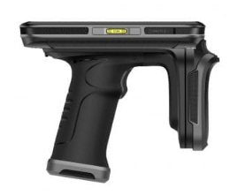
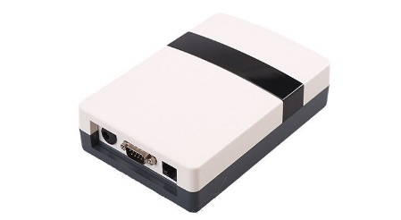
Key Hardware Components
RFID Tags
RFID Handheld Reader
RFID Desktop Reader
RFID Printer

Slide 11
Optional Hardware
RFID Smart Interactive Tray
Interactive Session with less manpower
Display of Products with specifications
Auto-comparison feature
Real-time information display
Enhanced shopping experience
Intelligent Store Management

Slide 12
Software Application
Desktop View

Slide 13
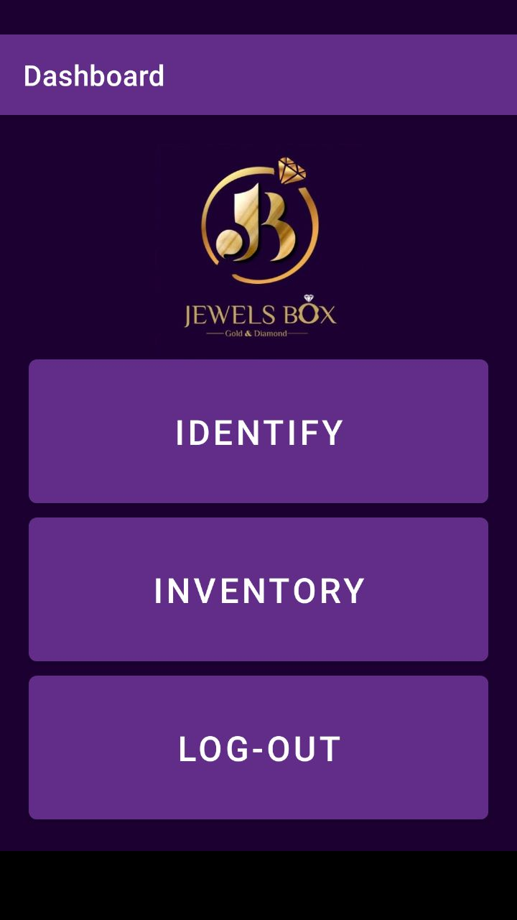
Software Application
Handheld Reader (Android) View
Android Application
Identify any
jewelry item
Take inventory
counter-wise

Slide 14
Software Features
Multi Location
Stock Check
Remote Application
Import Data
Automated Reports
Category & Zone
Breakdown
Stock Hold, In/Out Report
Identify Jewelry
Item
Stock Repair & Exchange Report

Slide 15
Clientele
and many more …

Slide 16
ID Tech Solutions Pvt. Ltd.
Plot No. 610 Udyog Vihar Phase V, Gurugram, Haryana
www.idsolutionsindia.com
THANK YOU

